Slide 1
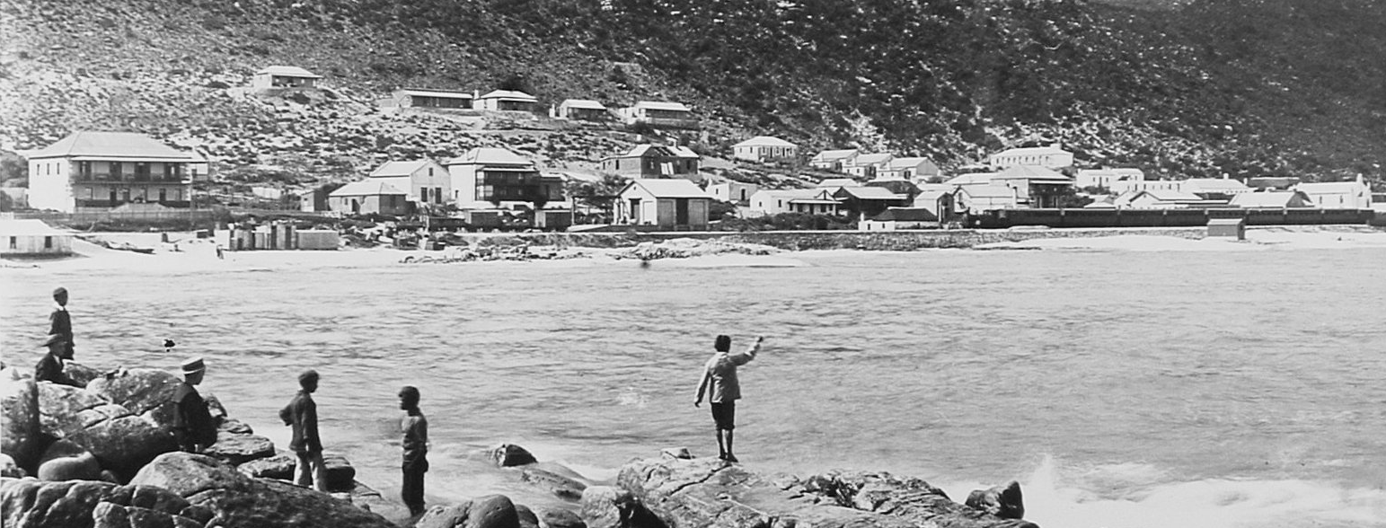

MUIZENBERG/ ST JAMES/ KALK BAY MANAGEMENT OF FIRE AND BIODIVERSITY Roles and Responsibilities
Environmental Management Department
Crispin Barrett

Slide 2
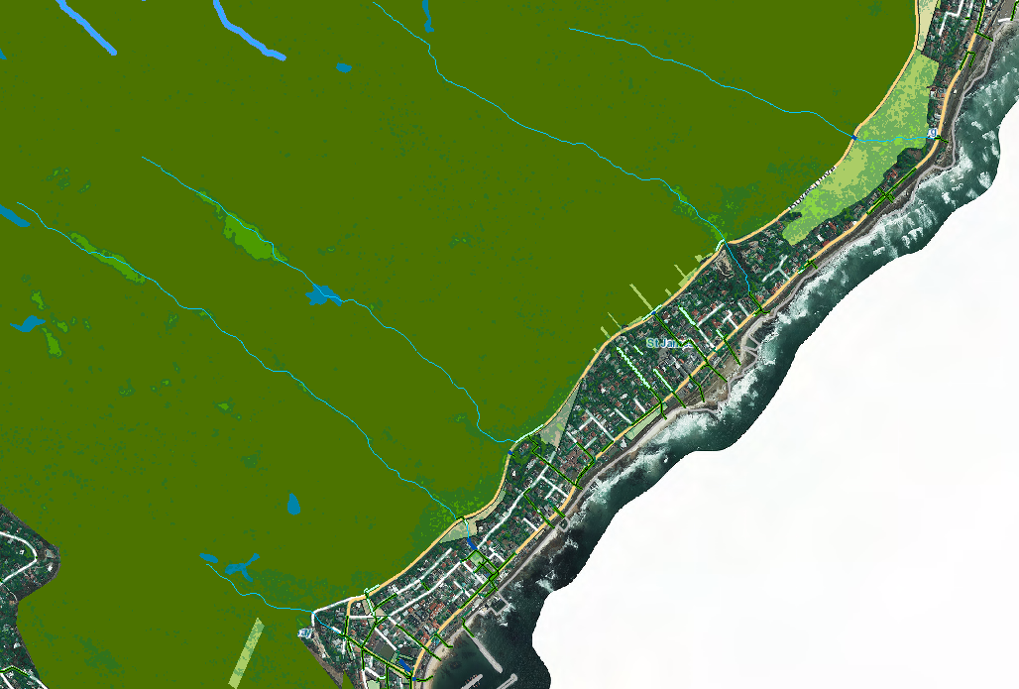
Contents
Introduction (where we, EMS, fit in)
Fire Management
Biodiversity Management
Exotic and Invasive Vegetation
Public Open Space Management
Available Resources
Roles and Responsibilities

Slide 3
Introduction
National Veld and Forest Fire Act 101 of 1998
Department of Forestry, Fisheries and Environment – DFFE
Local Authority
City of Cape Town - CoCT
CITY OF CAPE TOWN
Spatial Planning & Environment Directorate
Environmental Management Department
Environment & Heritage Management Branch
Environmental Management Section - EMS

Slide 4
Fire Management
National Veld and Forest Fire Act 101 of 1998 (NVFFA)
What is the National Veld and Forest Fire Act? - The purpose of the Act is to prevent and combat veld, forest and mountain Fires throughout the Republic. It provides for a variety of institutions, methods and practices to achieve its purpose. (e.g. FPAs).
What does the NVFFA promote? - The purpose of the NVFFA is to encourage the development of fire management practices, which are aimed at preventing, combating and minimising veld, forest and mountain fires throughout South Africa.
Municipal level – Fire and Rescue Services Department
Assisted by Volunteer Wildfire Services
Table Mountain National Park Fire Fighting Teams

Slide 5
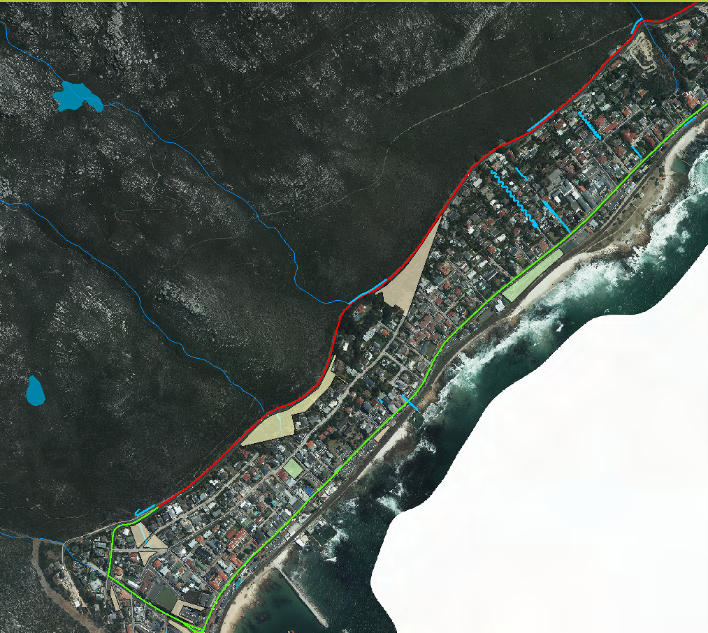
Extent of existing Urban Edge Fire Break & Public Open Spaces

Slide 6
Biodiversity Management
Biodiversity Management
Management of Alien and Exotic Species
Environmental Conservation Act (ECA) 73 of 1989
Conservation of Agricultural Resources Act (CARA) 43 of 1983
What is the conservation of agricultural resources Act South Africa? –
“To provide for control over the utilization of the natural agricultural resources of the Republic in order to promote the conservation of the soil, the water sources and the vegetation and the combating of weeds and invader plants; and for matters connected therewith…”
National Environmental Management Biodiversity Act (NEMBA)
Public Open Space
Municipal By-Laws

Slide 7
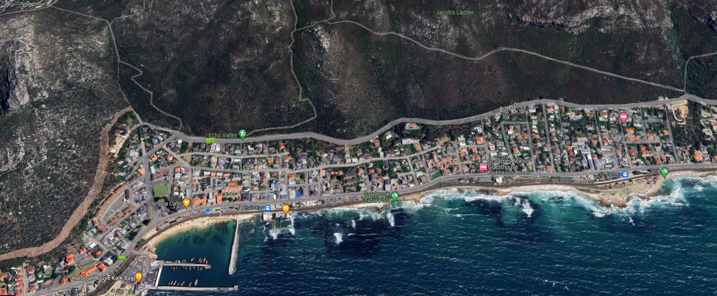
Available Resources
Public Open Space Services
Invasive Vegetation Management Services – Biodiversity Management Branch
Fire Services
Advice from City E&HM Branch

Slide 8
Roles and Responsibilities
Shared responsibility to retain significance and character through community working with the relevant departments to assist in management of the spaces
Community
To create working groups for the Public Open Spaces.
To communicate to the delegated department/s on relevant concerns.
City
To ensure annual management programmes are in place and followed through with to prevent, minimise or mitigate fuel load accumulation
To be accessible and available for consultation
To be consistent and timeous
To ensure compliance

Slide 9
For queries contact Crispin Barrett
CrispinRhodes.Barrett@capetown.gov.za / 021 444 2613

